Slide 1

IAD/Blockchain Project Update 30th September
Stefan Roata

Slide 2
Recap from last week
Last week, we have noticed that our collection of extracted websites contains foreign language texts that are very large (between 1000 and 400.000 characters).
Language translation using any python package requires that the texts be less than 5000 characters each. There were two proposed solutions for this:
1. Splitting the long foreign language texts into chunks of 5000 characters, translating the chunks separately and then merging the translated chunks together to yield the desired translation
2. Restricting each document (be it in a foreign language or in English) to 5000 characters each
By deliberation, we have decided to stick with the second solution. For this, we have enviosioned a model validation pipeline described as follows:
Run LDA only on the English texts for the moment, without truncating them to 5000 characters
Run LDA only on English texts, but truncate each of those to only 5000 characters
We wanted to see whether the 2 resulting topic models are different, so that we can know the impact of reducing the number of characters on general topic distribution.

Slide 3

1. NON-TRUNCATED DATA

Slide 4
Brief Data Preprocessing Step
Tokenize the texts and remove the stopwords
!!! The stopwords list needs to be updated too. What I have so far is the standard stop word list that comes with the NLTK python package, plus the following words:
Make bigrams and trigrams for the pairs of 2 and 3 words that appear often enough in the texts
Lemmatize the tokens (i.e. reduce related words to the same common root; e.g. walking -> walk)

Slide 5
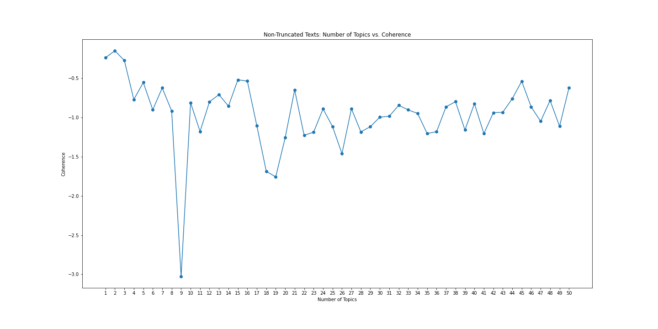
Model Selection using Cross-Validation based on UMass Coherence Score

Slide 6
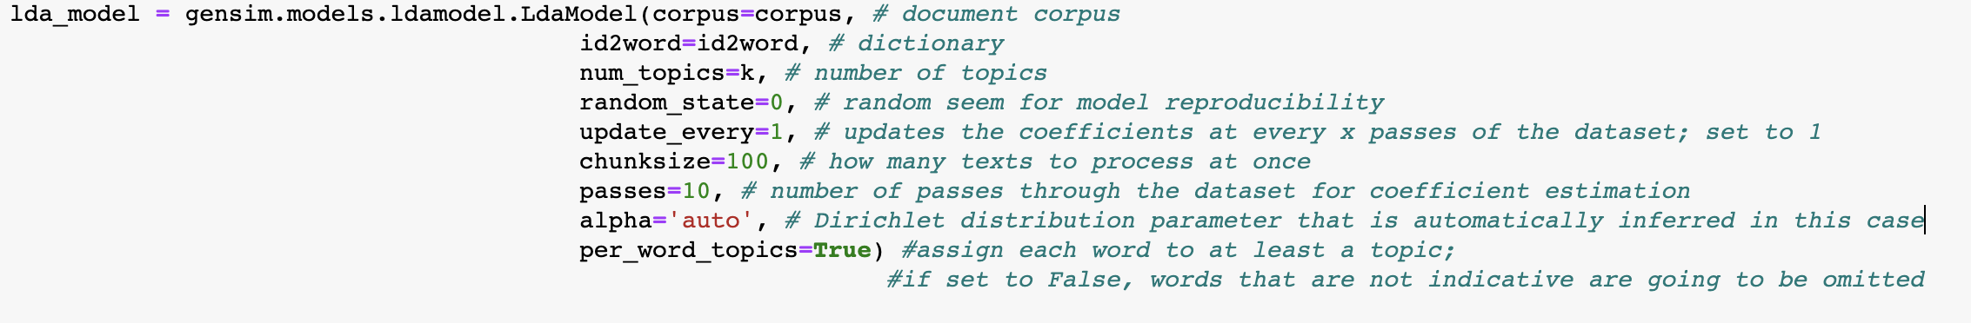
Model Parameters for each choice of k-topics
Topic readability can be increased by doing one of 3 things:
Changing the number of topics
Increasing number of passes (10 passes each for 50 models tried took 1.5 hours on the clock)
Decreasing chunk size

Slide 7
Chosen number of topics: 15 or 16
A number of topics equal to 45 was deemed not appropriate, because the number is a bit too large (it might be interesting to visualize though)
The first step to visualizing the topic distributions: pyLDAvis
Interpreting the lambda slider:
You can adjust the words displayed in the bar chart for a topic by adjusting the λ (lambda) slider. Adjusting lambda to values close to 0 highlights potentially rare but more exclusive terms for the selected topic. Larger lambda values (closer to 1) highlight more frequently occurring terms in the document that might not be exclusive to the topic. The authors of this visualization found in a user study that a λ value close to 0.6 was optimal for interpreting the topics, although they expected this value to change based on the data and individual topics.
Other resources: txt files with the composition of each topic (on Slack)
Open nontruncated_15topics_pyLDAvis.html and nontruncated_16topics_pyLDAvis.html

Slide 8
Next Steps
For either one of the models, the last 3 topics of each are repeated (i.e. they overlap entirely) and are full of gibberish words. This is bound to happen if the chosen number of topics is too large. To change readability of the topics, either one of the following things can be done to the models:
Necessary steps:
Update the stop words list to include the gibberish words
Increasing the “number of passes” parameter
Increasing chunk size
Question: Should I just update the parameters of the current models (15t/16t)? Or should I re-run the selection process for k_topics = 1…50 again with the new parameters?
(Think about computation time as well).

